Slide 1
Object Oriented Programming

Slide 2
Objectives
Define OO principles like
encapsulation
Abstraction
Inheritance
Polymorphism
Abstract class
interface

Slide 3
Procedure-Oriented Programming
Emphasis is on algorithms
Large programs are divided into smaller programs known as functions
Most of the functions share global data
Data moves openly around the system from function to function
Functions transform data from one form to another
Employs top-down approach in program design
Works great for smaller systems (<50,000 LOC) but fails for larger systems
Complex data, behavioural relationships
Increased coupling

Slide 4

Object-Oriented Programming
OOP is a programming paradigm that focuses on the objects in a software system similar to that of real world.
Objects communicate with each other by sending messages.

Slide 5
Object Oriented Programming central concepts
Abstraction
Modularity
Encapsulation
Inheritance
Polymorphism

Slide 6

Abstraction
Emphasize details that are significant to the viewer and suppress details that do not matter
An abstraction denotes the essential characteristics of an object relative to the perspective of the viewer
TV viewer
TV Technician

Slide 7
Abstraction
Abstraction is the process of capturing the essential while suppressing the detail
An abstraction is encapsulated by a well-defined interface, which defines how the abstraction can be used
A car's interface consists of steering wheel, accelerator, brake, etc.
We do not need to continually adjust the fuel/air mixture to drive the car - it is hidden from us.

Slide 8
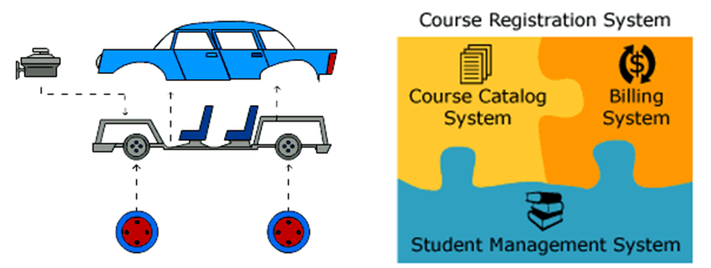
Modularity
A program is partitioned into individual components to reduce the complexity

Slide 9
Encapsulation
Encapsulation is an information hiding mechanism that hides detailed internal information about an abstraction
The mechanical devices of your car are encapsulated (hidden) by the chassis of the car
This insulation of the data from direct access by the program is called data hiding or information hiding
Eliminates direct dependencies on the implementation

Slide 10
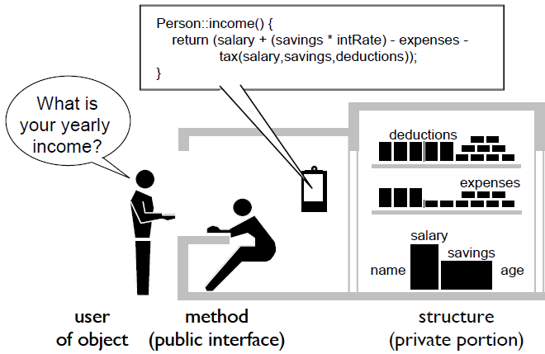
Encapsulation
When the user object asks for the yearly income, the person represented as public interface is going to do all the computation by himself.
The user object does not know that the person represented by public interface has considered SAVINGS, TAX, etc.
My Total Income:
SALARY PLUS (SAVINGS * INTERESTRATE)
DEDUCT EXPENSES
DEDUCT TAX ON SALARY, SAVINGS, DEDUCTIONS

Slide 11
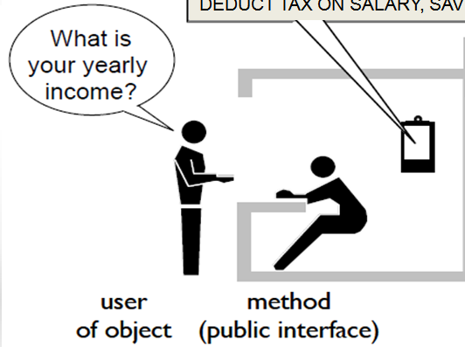


Encapsulation
Now when the user object asks for the yearly income, the person represented as public interface is now asking the secretary about the income.
Secretary give my INCOME REPORT
The secretary is using accountancy package in computer to compute the income.

Slide 12
Encapsulation
 | Builder | User
Goal | Create a reusable, maintainable code with an understandable interface | Quickly get and use a code
Approach | Hide structure and implementation details from user. | Examine and use operations exposed through an interface.
Benefits | May change structure and algorithms without affecting user | Understandable interface; can be used without fear of "breaking" object
Costs | Reusability must be carefully planned | Access to data through operations may be slower than direct access

Slide 13



Objects
What type of Objects are they?
What are the different states of these objects?
What is the common behavior among them?

Slide 14
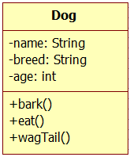
Objects state and behavior
All the objects are of type Dog
Every dog has the following states name, breed and size.
Every dog does the following: barks, eats, sleeps and wags its tail.
This generalization is referred as a Class.
state
behavior
Class
Objects

Slide 15


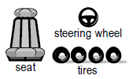

OO Real world and software
Real World
Software
Car
model
chassisNo
regNo
start
stop
turn
accelerate
Objects / instances
myCar
myDadsCar
myFriendCar
myCar
myDadsCar
State
model: Rapid
chassisNo: AE122011
regNo: KA-50-1233
model: WangonR
chassisNo : LK922T3
regNo: KA-04-8222
myCar.start( );
myCar.shiftGear();
myCar.accelerate( );
myCar.turn(LEFT);
myDadsCar.start( );
myDadsCar.stop( );
Behavior

Slide 16
Constructors
A constructor is a special method that is called to initialize default values to data members (fields) of a class
It does not create object
Constructor’s name is same as that of the class.
Constructor does not return anything

Slide 17
Default Constructor
Features of a default constructor
Public accessibility
Same name as the class
No return type—not even void
Expects no arguments
Initializes all fields to zero, false or null

Slide 18
Overloaded Constructor
Constructors are methods and hence can be overloaded
Same scope, same name, different parameters
Allows objects to be initialized in different ways
WARNING
If you write a overloaded constructor for a class, the compiler does not create a default constructor

Slide 19
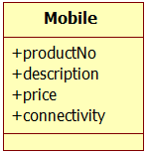



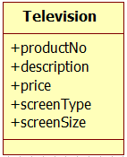


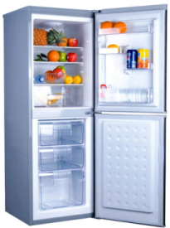
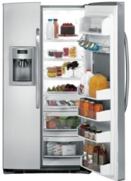
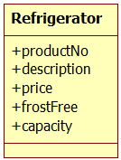
Generalization
Different products and their attributes

Slide 20
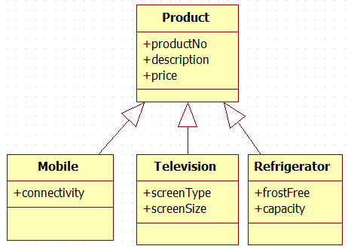


Inheritance
Move the common attributes and behavior up the tree.
Specialization
Generalization
productNumber : 544
description: G Android Mobile
price: 25000.55
Connectivity: 3G
productNumber : 122
description: ABC TV
price: 65000.55
screenSizeInInches: 42
screenType : LCD

Slide 21
Inheritance
Inheritance is the ability to derive new classes from existing ones. A derived class ("subclass") inherits the instance variables and methods of the base class (“parent class"), and may add new instance variables and methods.
Inheritance defines a hierarchical relationship among classes wherein one class shares the attributes and methods defined in one or more classes.
Inheritance is a relationship among classes in which one class shares the structure and behavior of another. A subclass inherits from a base class.

Slide 22
Relationships of Inheritance
Inheritance specifies an “is a kind of" relationship
Inheritance is a class relationship
New classes specialize existing classes
Generalization
Musician
Base class
Specialization
Violin
Player
Derived class

Slide 23
Class Hierarchies
Classes related by inheritance form class hierarchies
Musician
plays
Musical
Instrument
String
Musician
plays
Stringed
Instrument
???
Violin
Player
plays
Violin
???

Slide 24
Single and Multiple Inheritance
Single inheritance: deriving from one base class
Multilevel inheritance: a class derives from a base class which derives from another base class
Multiple inheritance: deriving from two or more base classes
Stringed
Instrument
Musical
Instrument
Pluckable
Violin
Stringed
Instrument
Violin has a single direct base class
Stringed Instrument has two direct base classes

Slide 25
Polymorphism
Polymorphism is the provision of a single interface to entities of different types. A polymorphic type is one whose operations can also be applied to values of some other type, or types.
Polymorphism can be distinguished by when the implementation is selected: statically (at compile time) or dynamically (at run time, typically via a virtual function).
This is known respectively as static dispatch and dynamic dispatch, and the corresponding forms of polymorphism are accordingly called static polymorphism and dynamic polymorphism.

Slide 26
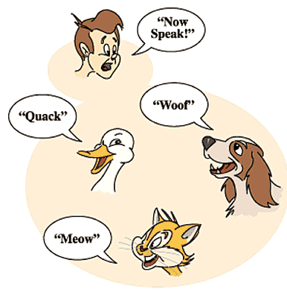
Dynamic Polymorphism
Polymorphism is the ability of different objects to respond in their own unique way to the same message

Slide 27
Static Polymorphism
Method/Function overloading is a great example of static polymorphism
Same function name can be used to do multiple operations
During compilation time the function being called is decided and bound to the function call
Also, operator overloading is another great example of static polymorphism
Static polymorphism executes faster, because there is no dynamic dispatch overhead, but requires additional compiler support.
Further, static polymorphism allows greater static analysis, by compilers (notably for optimization), source code analysis tools, and human readers (programmers).

Slide 28
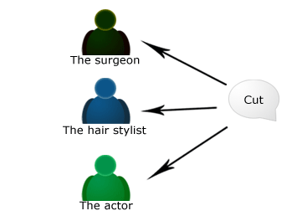
Dynamic Polymorphism Question
How do they react if someone says “CUT” to these people?
Notes:
For the same message “cut”:
The Surgeon would begin to make an incision (slit).
The hair stylist would begin to cut someone’s hair.
The actor would abruptly stop acting the current scene, awaiting directorial guidance.

Slide 29
Destructor
In object-oriented programming, a destructor (dtor) is a method which is automatically invoked when the object is destroyed.
It can happen when its lifetime is bound to scope and the execution leaves the scope, when it is embedded in another object whose lifetime ends, or when it was allocated dynamically and is released explicitly.

Slide 30
Destructor (Contd.)
Its main purpose is to free the resources (memory allocations, open files or sockets, database connections, resource locks, etc.) which were acquired by the object during its life and/or deregister from other entities which may keep references to it.
Use of destructors is needed for the process of Resource Acquisition Is Initialization (RAII).

Slide 31
Destructor (Contd.)
In a language with an automatic garbage collection mechanism, it would be difficult to deterministically ensure the invocation of a destructor, and hence these languages are generally considered unsuitable for RAII.
In such languages, unlinking an object from existing resources must be done by an explicit call of an appropriate function (usually called Dispose()).
This method is also recommended for freeing resources, rather than using finalizers for that.

Slide 32
Destructor in Different Programming Languages
In C++, destructors have the same name as the class with which they are associated, but with a tilde (~) prefix.
In D, destructors are declared with name ~this() (whereas constructors are declared with this()).
In Object Pascal, destructors have the keyword destructor and can have user-defined names, but are mostly named Destroy.
In Objective-C, the destructor method is named dealloc.
In Perl, the destructor method is named DESTROY; in the Moose object system extension, it is named DEMOLISH.
In PHP 5, the destructor method is named __destruct. There were no destructors in prior versions of PHP.[1]
In Python, the destructor method is named __del__.[2]
In Swift, the destructor method is named deinit.

